Slide 1
JUSTTANNED.COM
Mr. Pratik Jain, (Roll No. 181080050), SY(IT)
Mr. Rishab Munot, (Roll No. 181080053), SY(IT)
Mr. Hrushikesh Kuklare, (Roll No. 181080041), SY(IT)
Mentors: Dr V B Nikam, Prof Mayuri More
Department of Computer Engg & IT

Slide 2
Problem Statement
Using the address(Latitudes and Longitudes) from the user database and supplier database to plot it on a map in QGIS and study it further to improve our marketing strategy, check the delivery time for the users and keep a check on the reach of our website across the world.

Slide 3
Data Type Used
We used vector layers for our project
It consists of two layers:
Base layer i.e. Shape File
Point Layer (Users) i.e. Coordinates
Point Layer (Supplier) i.e. Coordinates

Slide 4
Coordinate System
We are using a coordinate system of latitude-longitude which are often referred to as geographic coordinate systems.

Slide 5
Data Acquisition Methods:
The base file i.e. shape file of Maharashtra can be easily found on the internet
The link for the same is mentioned in the below reference.
References : https://mapcruzin.com/free-maharashtra-country-city-place-gis-shapefiles.htm

Slide 6
Continue
Now coming to the point layer of users i.e. Latitudes and Longitudes
Being a E-commerce company it was relatively easy for us to get the address from the users on the sign up section.
Then we converted those address to Coordinates (i.e. Latitudes and Longitudes )

Slide 7
Continue
Now coming to the point layer of supplier i.e. Latitudes and Longitudes
Our suppliers provided us with their address.
Then we converted those address to Coordinates (i.e. Latitudes and Longitudes )

Slide 8
Geo-referencing
We are using geo-referencing to relate the coordinate system onto our base map projection.

Slide 9
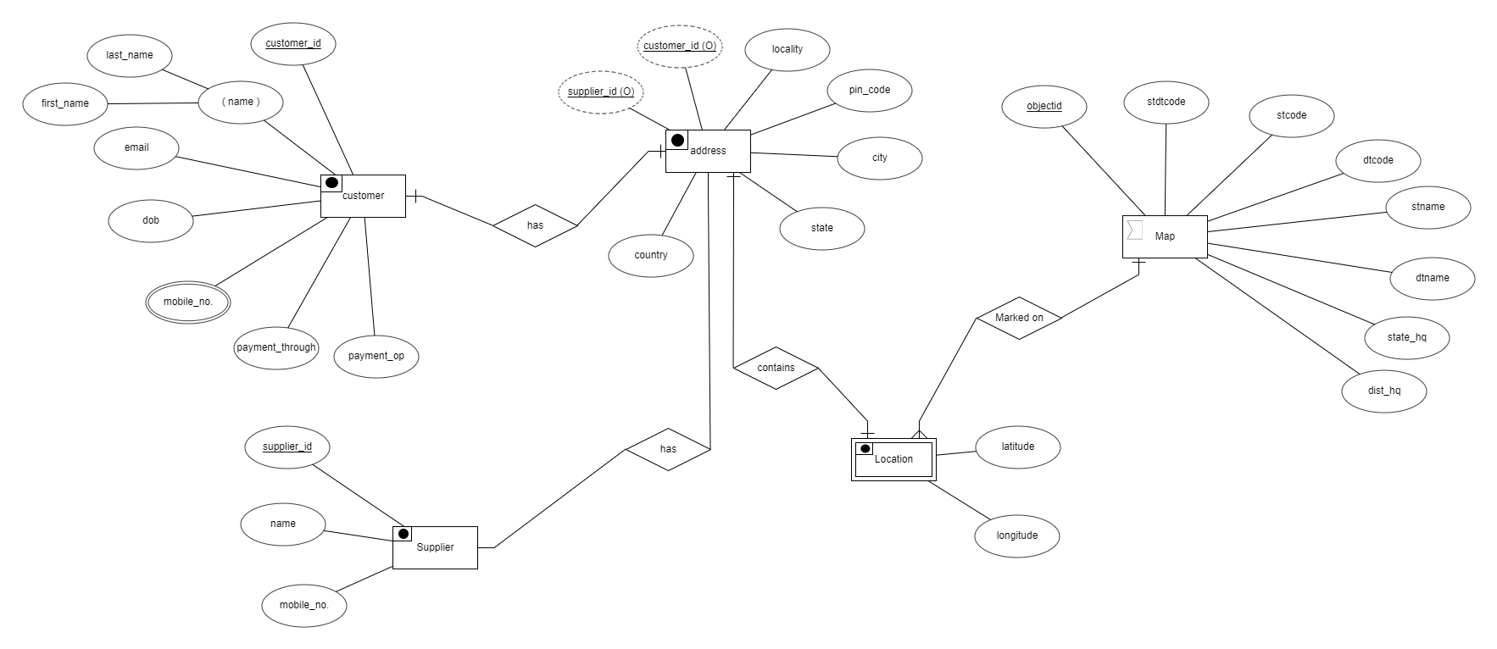
ER DIAGRAM

Slide 10
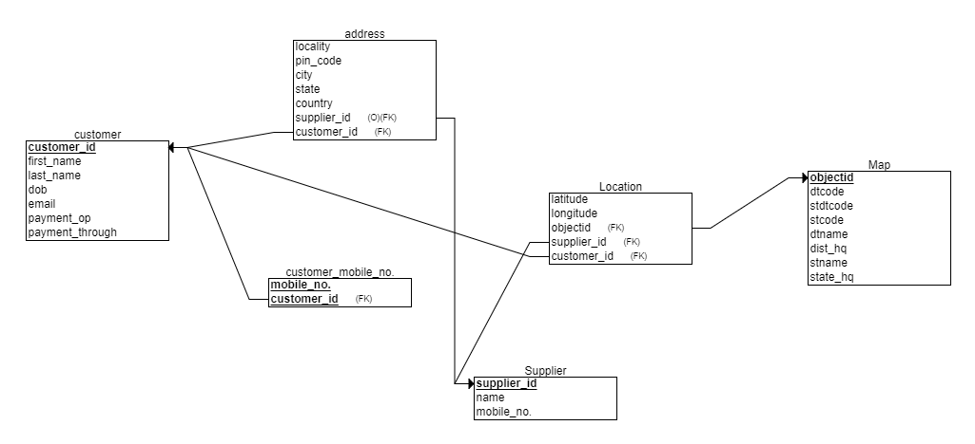
RELATION SCHEMA

Slide 11
Data Dictionary
Table | Coulmn | Data Types | References | Default | Not Null
Customer | customer_id | VARCHAR |  |  | Y
 | First Name | VARCHAR |  |  | Y
 | Last Name | VARCHAR
 | dob | VARCHAR |  |  | Y
 | email | VARCHAR |  |  | Y
 | payment option | VARCHAR
 | payment through | VARCHAR
address | locality | VARCHAR
 | pin_code | INT |  |  | Y
 | city | VARCHAR
 | state | VARCHAR
 | country | VARCHAR
 | supplier_id | VARCHAR | Supplier |  | Y
 | customer_id | VARCHAR | Customer |  | Y
customer mobile no | mobile_no | INT |  |  | Y
 | customer_id | VARCHAR | Customer
location | latitude | POINT |  |  | Y
 | longitude | POINT |  |  | Y
 | object_id | VARCHAR | Map |  | Y
 | supplier_id | VARCHAR | Supplier |  | Y
 | customer_id | VARCHAR | Customer |  | Y
Supplier | supplier_id | VARCHAR |  |  | Y
 | name | VARCHAR |  |  | Y
 | mobile_no | NUMBER |  |  | Y
Map | map_shape | POLYGON
 | object_id | VARCHAR |  |  | Y
 | dtcode | VARCHAR |  |  | Y
 | stdtcode | VARCHAR |  |  | Y
 | stcode | VARCHAR |  |  | Y
 | dtname | VARCHAR |  |  | Y
 | dist_hq | VARCHAR |  |  | Y
 | stname | VARCHAR |  |  | Y
 | state_hq | VARCHAR |  |  | Y

Slide 12
Continue
Primary Keys
Type | Table | Key | Column
Primary | Customer | pk_customer_id | customer_id
Primary | Customer Mobile | pk_mobile_no | mobile_no
Primary | Supplier | pk_supplier_id | supplier_id
Primary | Map | pk_object_id | object_id
Foreign Keys
Type | Table | Key | Column
Foreign | address | fk_supplier_id | supplier_id
Foreign | address | fk_customer_id | customer_id
Foreign | customer_mobile | fk_customer_id | customer_id
Foreign | location | fk_supplier_id | supplier_id
Foreign | location | fk_customer_id | customer_id
Foreign | Supplier | fk_supplier_id | supplier_id

Slide 13
What kind of layer did we use?
We use vector layers in our project cause the plotting and the visualization o data is better and relatively easy in it.
References : https://gisgeography.com/spatial-data-types-vector-raster/

Slide 14
Data capture methods:
For our project we used Remote sensing data acquisition technologies to acquired our base map.
And then we converted those layer into vector format and got the shape file of Maharashtra
References : https://mapcruzin.com/free-maharashtra-country-city-place-gis-shapefiles.htm

Slide 15
Continue
Since we were currently only focussing on Mumbai and it’s neighbouring regions and we can't find any Mumbai shape file we queried the Mumbai region from Maharashtra with the following query in QGIS:
"dist_hq" = 'ALIBAG' OR "dist_hq" = 'MUMBAI' OR "dist_hq" = 'BANDRA' OR "dist_hq" = 'THANE'
References : https://mapcruzin.com/free-maharashtra-country-city-place-gis-shapefiles.htm

Slide 16
Continue
Coming to the point layers, we received those data by Fields Survey data acquisition technologies method as the users themselves filled it on our website on the signup page

Slide 17
Map Visualization (Base layer)
We got the base layer by querying out the required part from the shape file
We labelled the regions in those layer.
References :

Slide 18
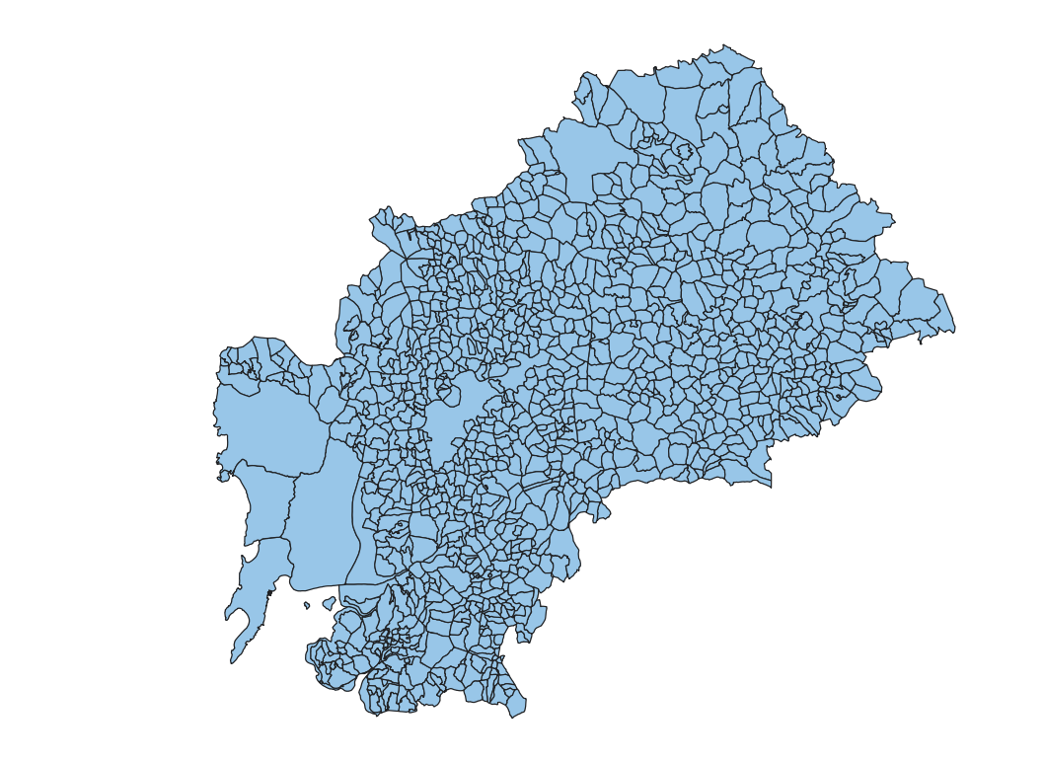
Continue
References : https://mapcruzin.com/free-maharashtra-country-city-place-gis-shapefiles.htm

Slide 19
Map Visualization (Points layer-Users)
We plotted the coordinates of the users on the shape file and sorted them based on there locality
Like in the next slide we can see that all regions are plotted with different coloured circles.

Slide 20
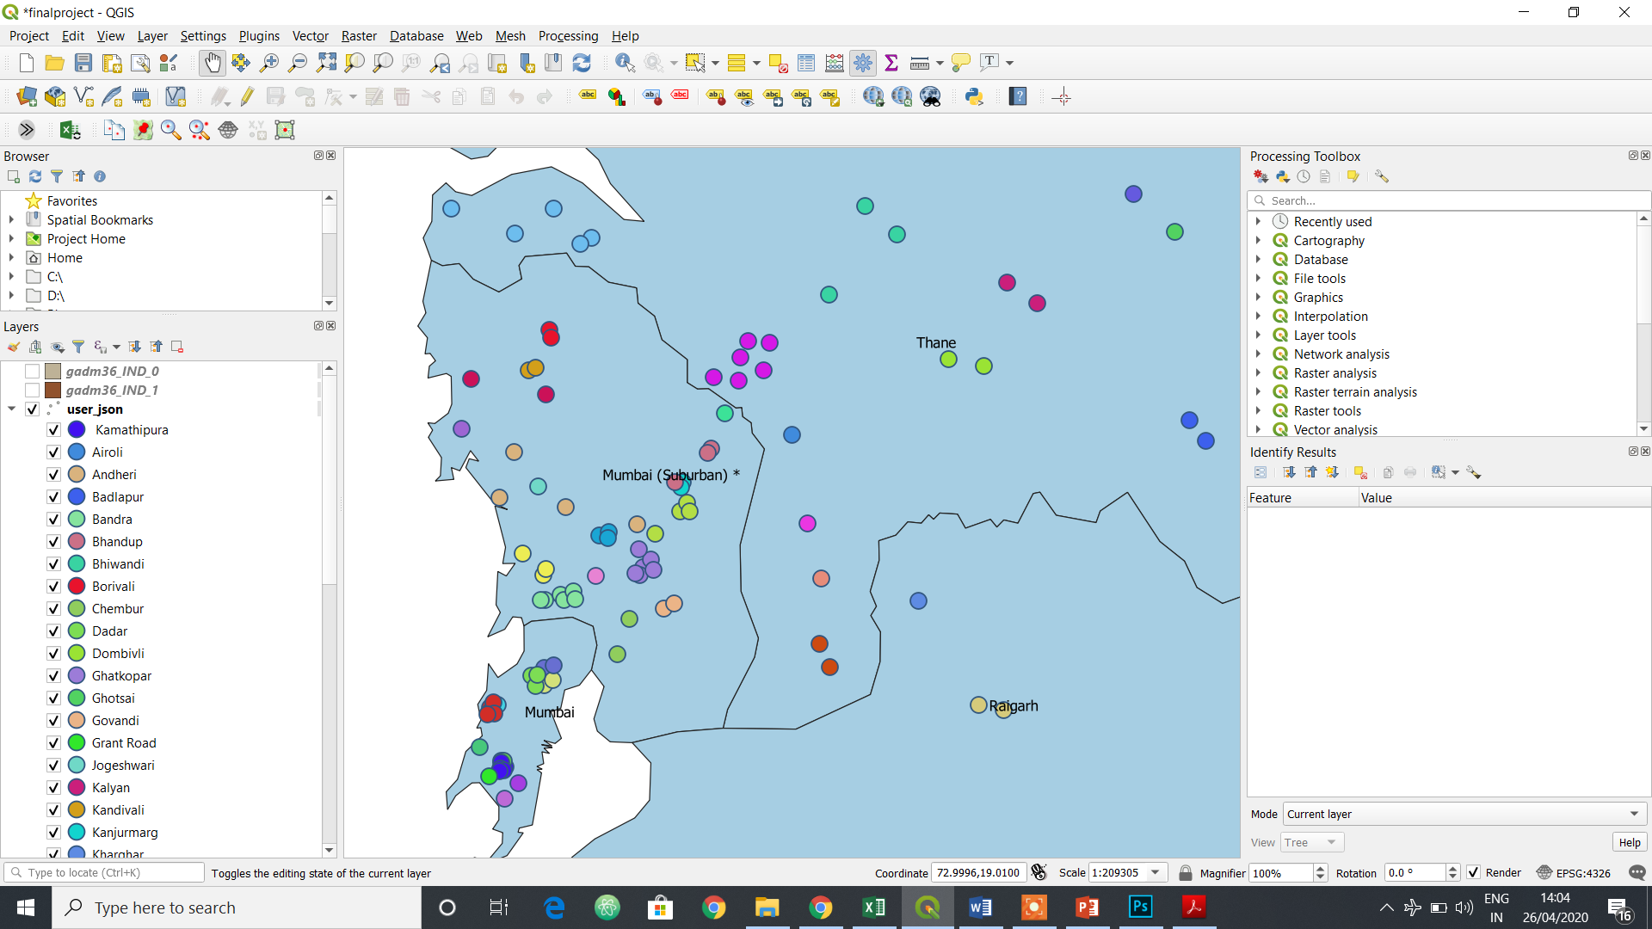
Continue

Slide 21
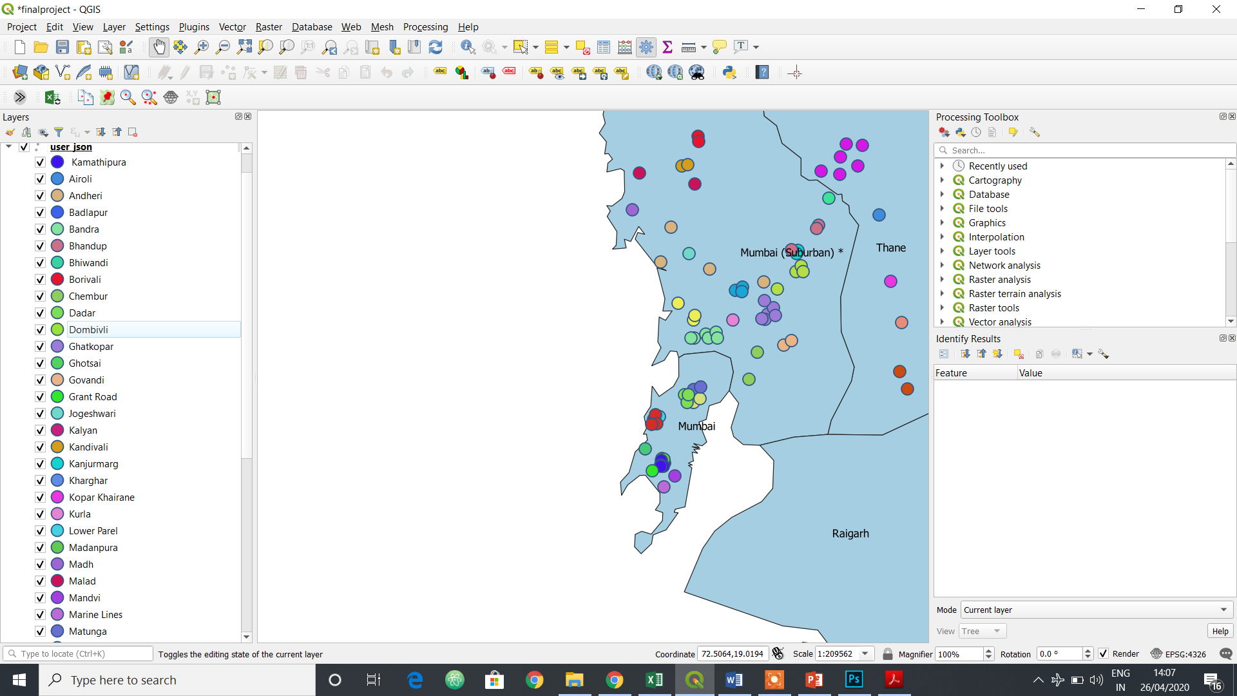
Continue

Slide 22
Map Visualization (Points layer-Supplier)
We plotted the coordinates of the supplier on the shape file and sorted them based on there locality.
Like in the next slide we can see that all regions are plotted with different coloured triangle.

Slide 23
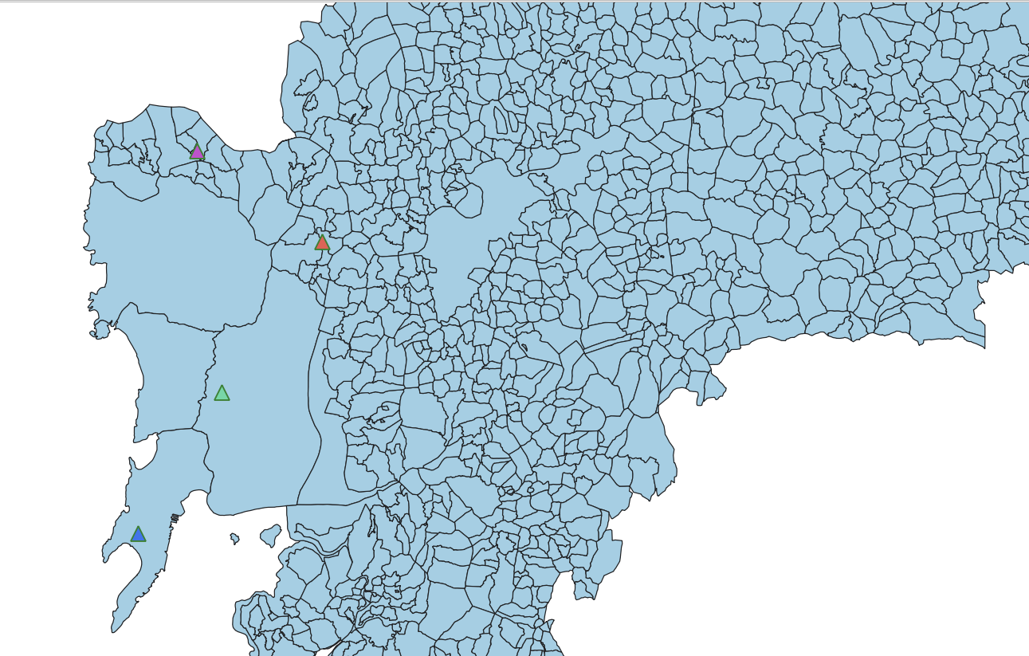
Continue

Slide 24
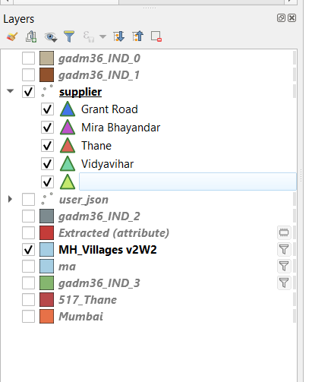
Continue

Slide 25
How did we map the maps in your project work ?
It’s simple , we used quantitative mapping to mark our users and suppliers in different regions based on different attributes.

Slide 26
Queries in QGIS:
An example if a query is to look to only those users to pay through Cash On Delivery which can be done using the query builder option in QGIS:
The query will be as follows
"payment_op" = 'Cash On Delivery'

Slide 27
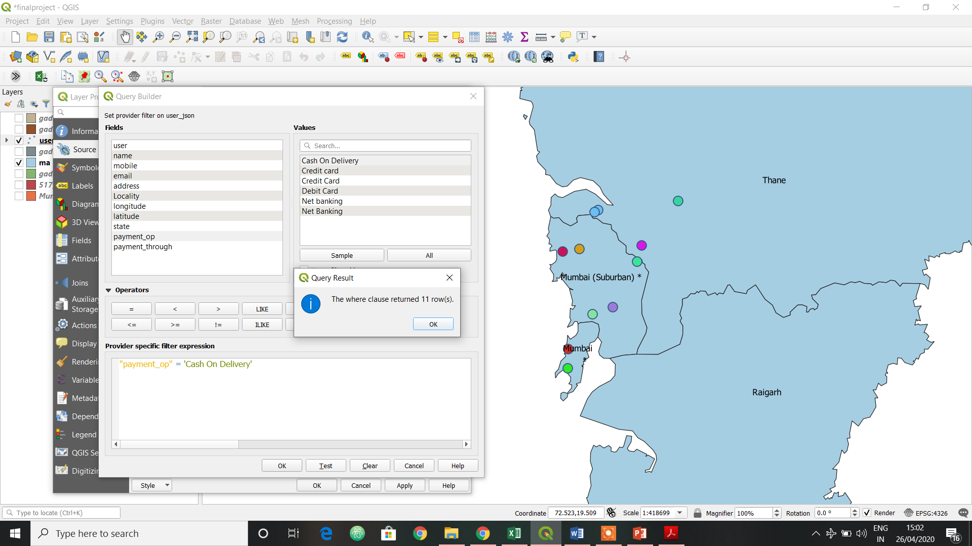
Continue

Slide 28
Spatial Analysis
Spatial analysis plays a huge part in our project.
We use different techniques to find out things like delivery time, no. of users within a fixed distance of the supplier.
An example of such query is use of buffer region to find the no. of users who will be getting one day delivery:
References :

Slide 29
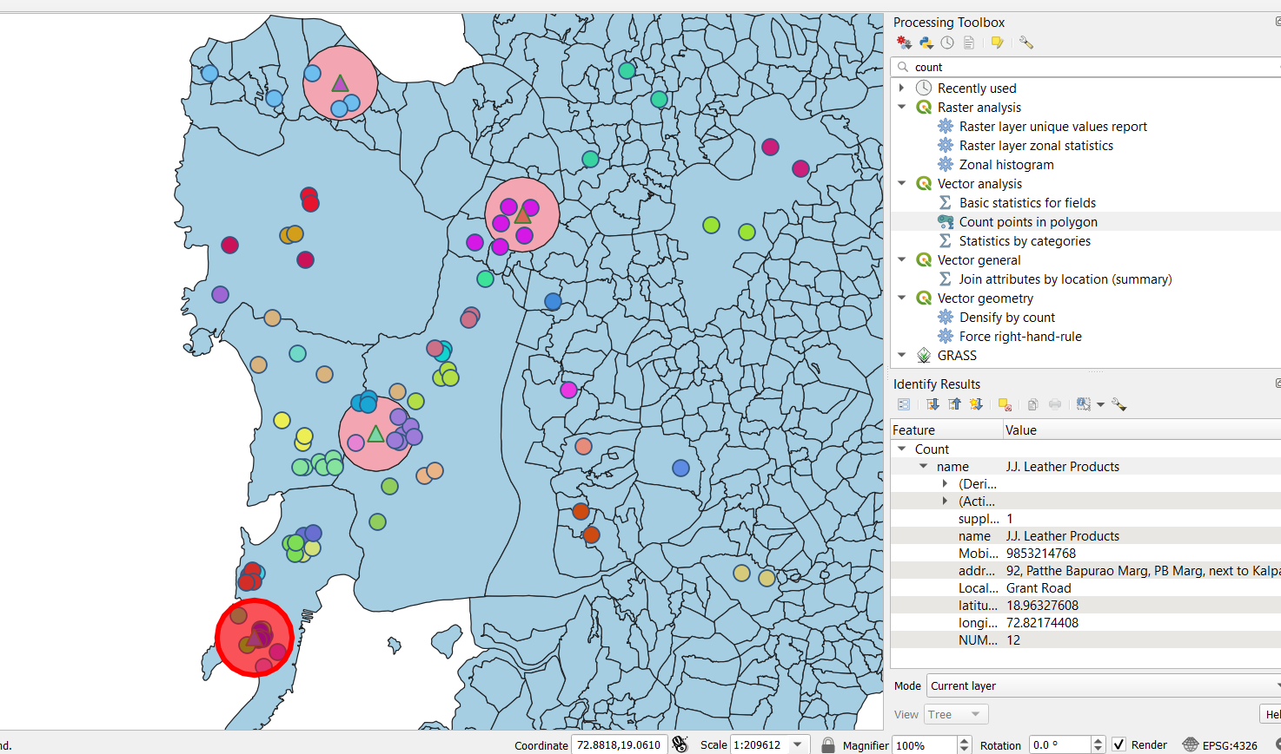
Continue

Slide 30
Importance of QGIS in our project
Qgis plays an integral part in our project which is very important for the future of our website.
We have started with relatively small area of Mumbai which we hope to expand in coming time and we will be doing so by studying the users with qgis and developing better marketing strategies.
References :

Slide 31
Continue
It helps us manage our users and suppliers and provides the necessary data about delivery and tracking.
It differentiates different delivery options based on the distance between the user and the nearest supplier which help us manage things

Slide 32
Other Application of QGIS that can implemented in our project in the coming future
To mark the fastest way to deliver the product based on the nearest transport facility available.
References :

Slide 33
Continue
2. Using geo tracing to track the product delivery for the users.
References :

Slide 34
Continue
3. Integrating GIS with our website to show users the some data about the supplier and tracking of there products.
References :

Slide 35
Future of our project
Since our current aim was to study the location of users and improve our marketing ideas and that’s what we are keen on doing so that we can market in areas with less density with different mediums of advertising.
Other aim was to show different users the delivery time based on there locale.

Slide 36
Continue
We hope to implement many more ideas in qgis and use it in it’s full capacity to become a successful website
References :

Slide 37
Additional References
https://gisgeography.com/spatial-data-types-vector-raster/
https://www.census.gov/geographies/mapping-files.html
https://www.researchgate.net/publication/224805896_Entity_relationship_modeling_of_spatial_data_for_geographic_information_systems
http://www.gitta.info/SpatialQueries/en/text/SpatialQueries.pdf
https://docs.microsoft.com/en-us/sql/relational-databases/spatial/spatial-data-types-overview?view=sql-server-ver15
https://documentation.qgis.org/

Slide 38
Acknowledgement
We take this opportunity to thank the Department of Computer Engg. & IT , VJTI for giving an opportunity to pursue this project work. Also, our special thanks to Faculty Development Centre (VJTI-DBATU) in Geo-informatics, Spatial Computing and Big Data Analytics, developed under the aegis of PMMMNMTT, MHRD, Govt of India, New Delhi, for capacity building in this domain, which helped us to take up this project work to deliverable level.

Slide 39
THANK YOU

